Slide 1
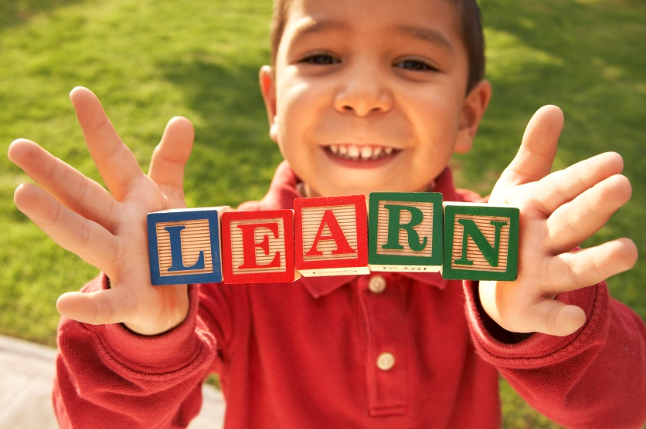
Meeting the Needs of all Learners:
Differentiation and the Common Core
Join Piedmont ALPS for an educational and networking event. A panel of our inspirational teachers will share how they work to meet the needs of a variety of learners in any subject. They will focus on how the Common Core will change opportunities for differentiation in classrooms. This event will focus on all grades.
Free to ALPS members,
$10 suggested donation for others.
Meeting the Needs of All Learners
Dec 2, 2014, 7:00-8:30 PM
Havens Elementary School Library
323 Highland Avenue
piedmontalps@gmail.com
WWW.PIEDMONTALPS.ORG

